Slide 1

Touchless Drone Control
Ivana Dukayová
November 22, 2023

Slide 2
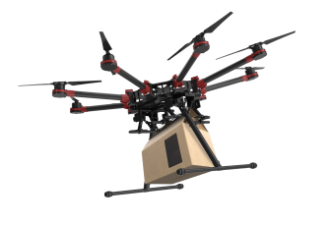
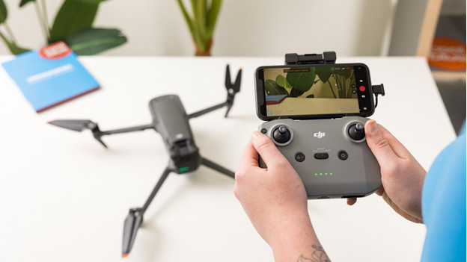
Motivation

Slide 3
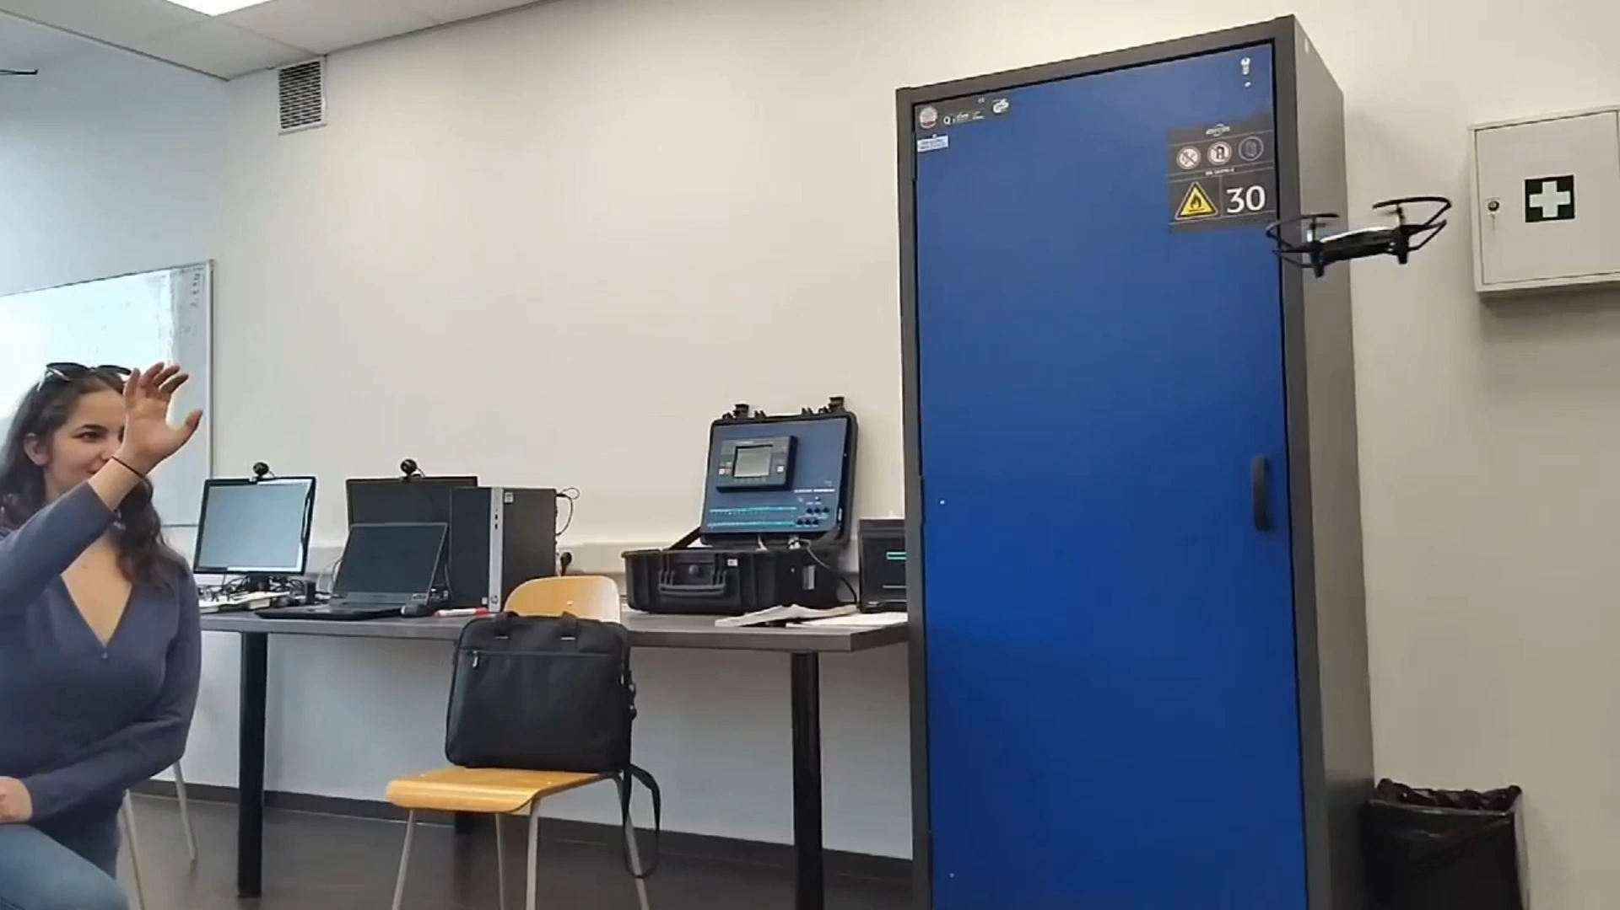
Our Goals

Slide 4
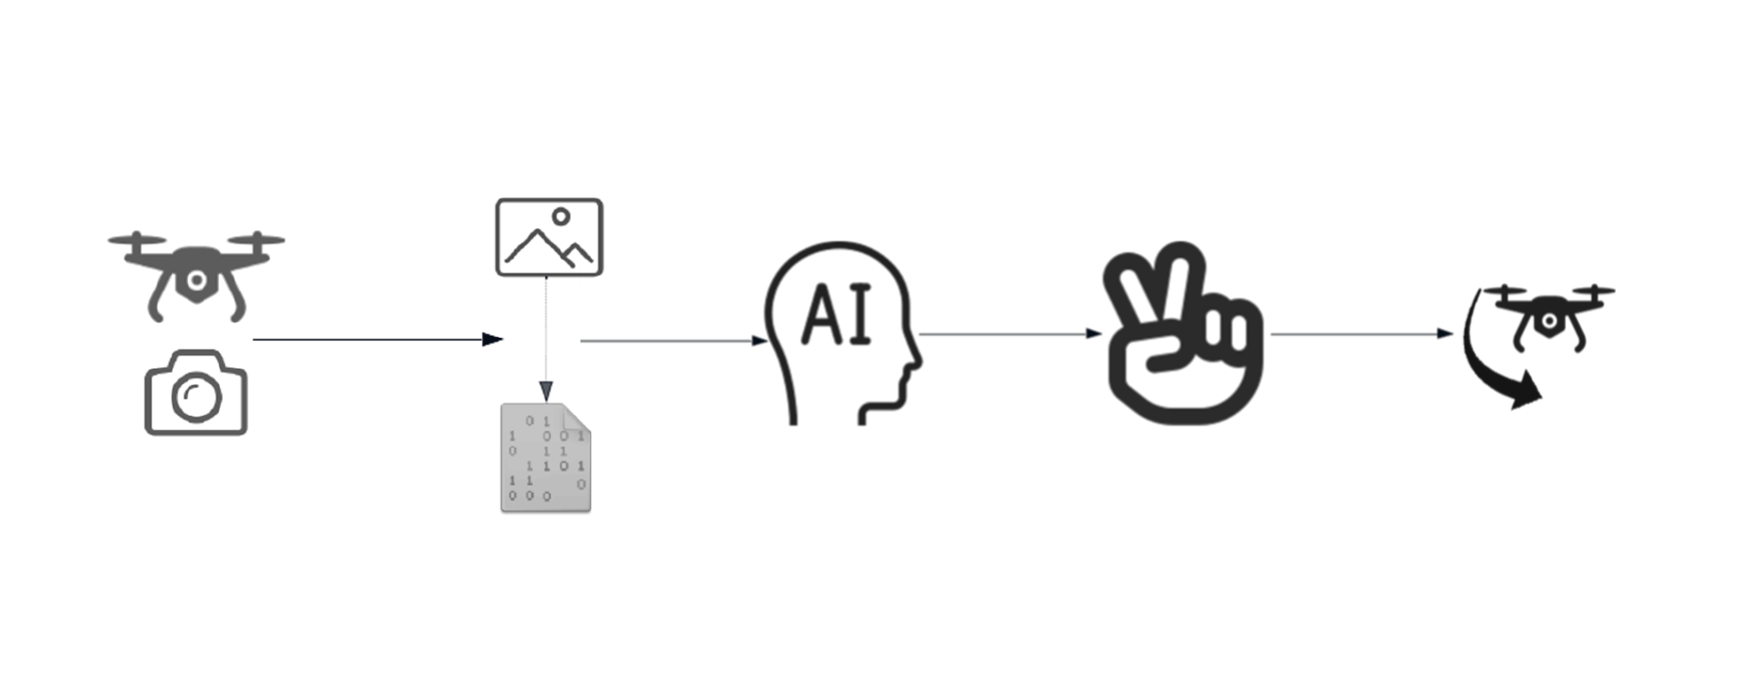
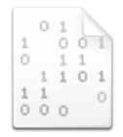
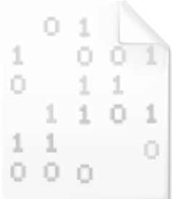
Our Goals

Slide 5
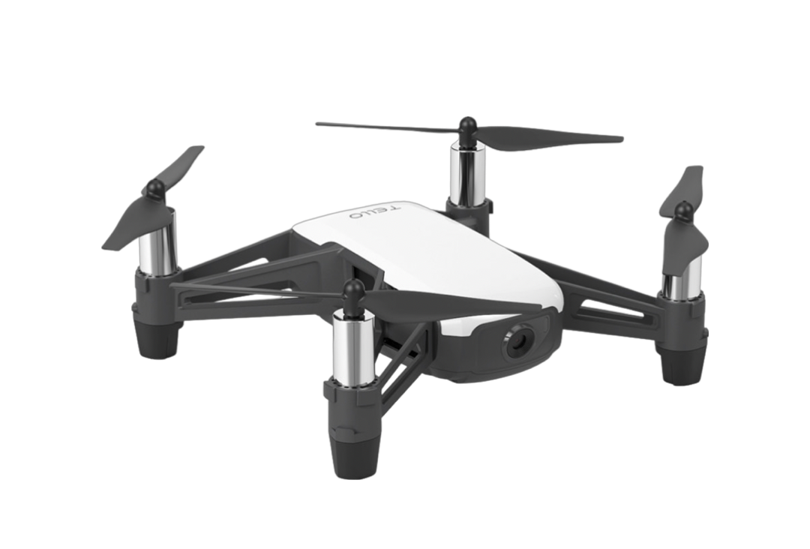
Tools
Python
OpenCV
TensorFlow
MediaPipe

Slide 6
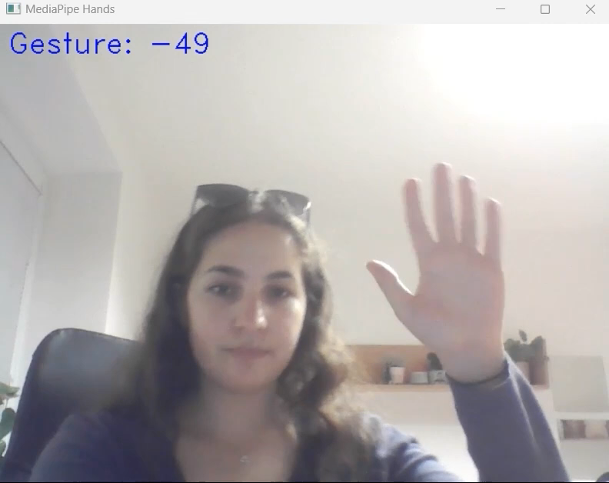
Data Collection

Slide 7
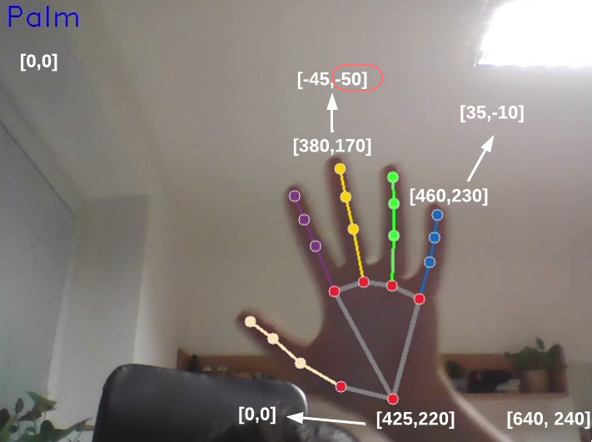
Data Normalization

Slide 8
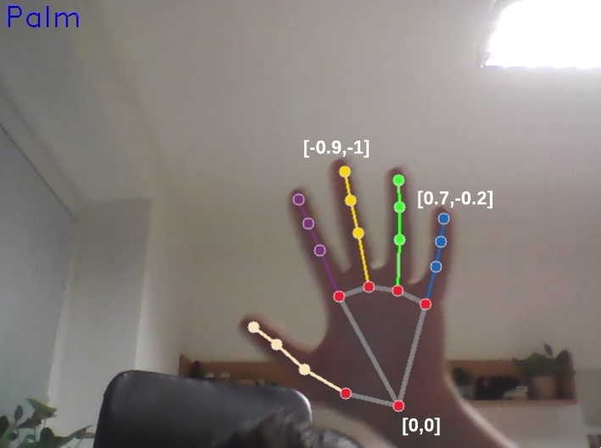
Data Normalization

Slide 9
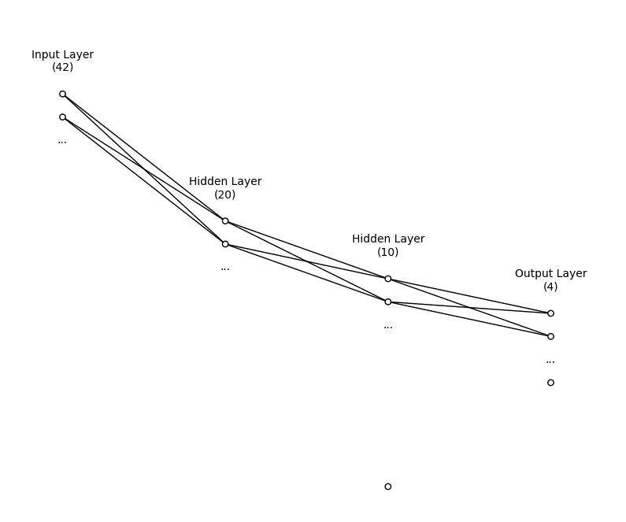
Our Model
Input layer – 42 neurons
2 hidden layers with 20 and 10 neurons
Output layer with 4 neurons
1114 total parameters

Slide 10
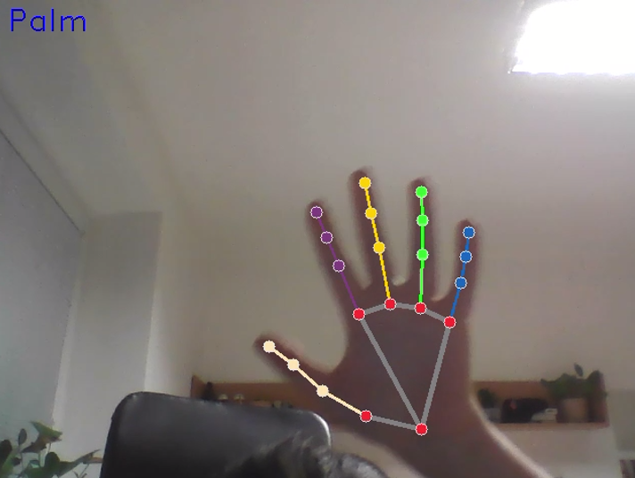
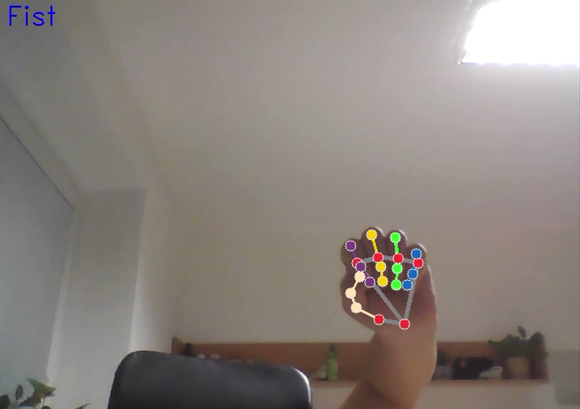
Gesture Recognition

Slide 11
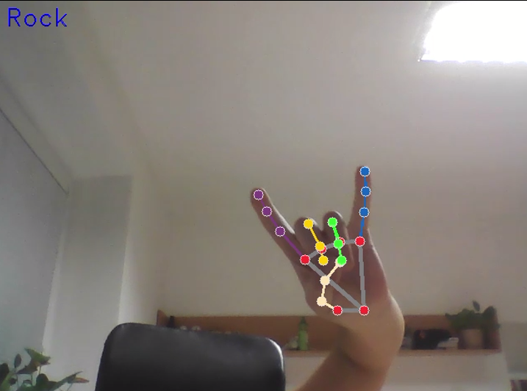
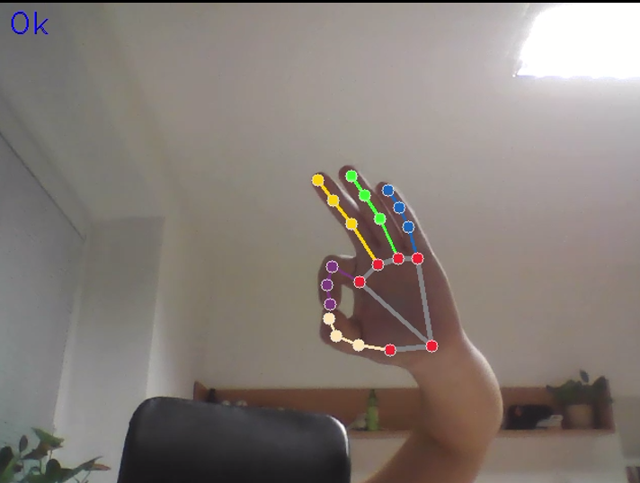
Gesture Recognition

Slide 12
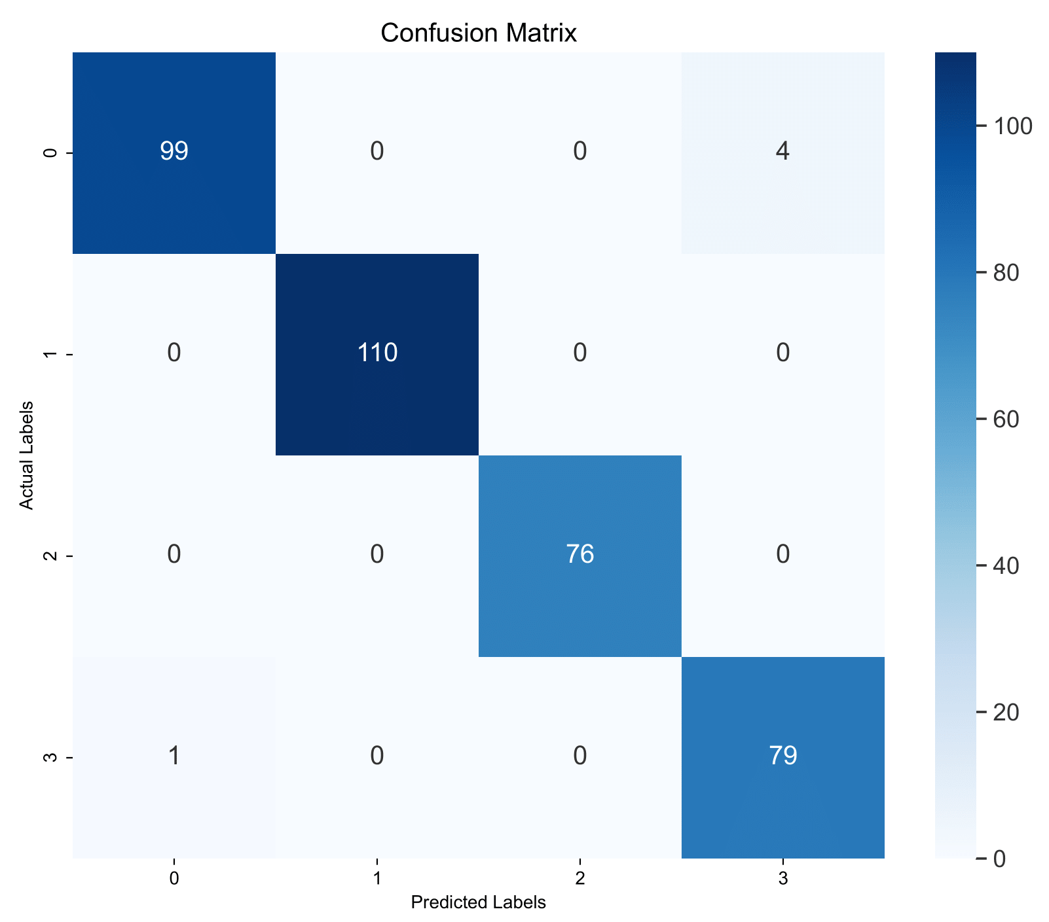
Model Evaluation

Slide 13
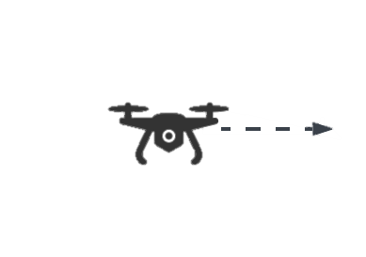
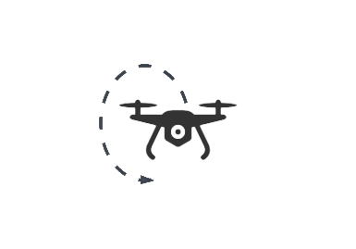
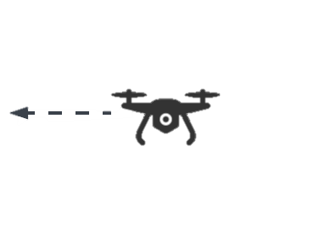
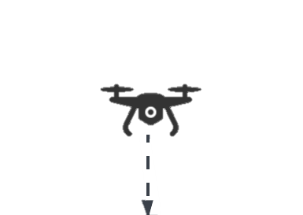
Drone Commands
Forward
Backward
Flip
Land

Slide 14
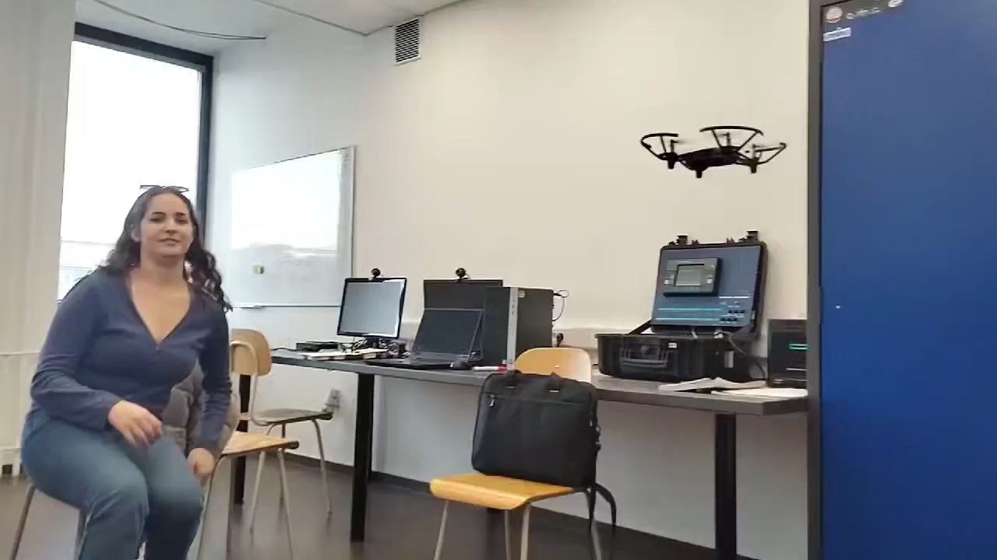
Results

Slide 15
Conclusion
Data Collection
Model Training
Drone Camera Capture
Conversion via OpenCV to Data
Gesture Guessing
Gesture to Command

Slide 16
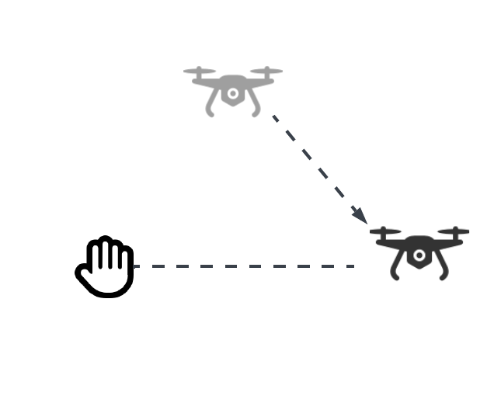
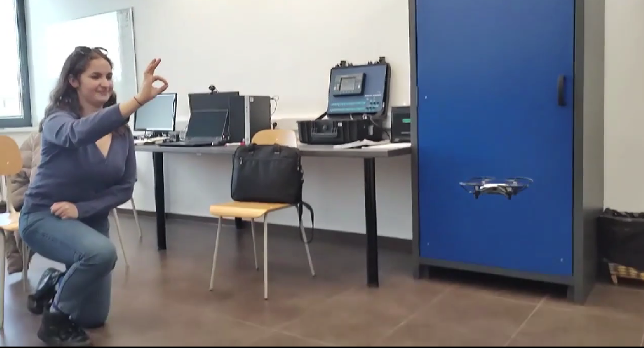
Bachelor Thesis
More Gestures
Human Detection
Hand Following

Slide 17
Conclusion
Data Collection
Model Training
Drone Camera Capture
Conversion via OpenCV to Data
Gesture Guessing
Gesture to Command

Slide 18
Resources
https://mediapipe-studio.webapps.google.com
https://www.ryzerobotics.com/tello
https://www.zero-x.com.au/product-force
https://lucid.app

